Slide 1
Employee Data Analysis using Excel
STUDENT NAME: M. Nayana dicksha
REGISTER NO:312208408 – Asunm1330312208408
DEPARTMENT:B.Com(Accounting and finance)
COLLEGE: Chellammal woman’s college

Slide 2

PROJECT TITLE
Employee Performance Analysis using Excel

Slide 3


AGENDA
Problem Statement
Project Overview
End Users
Our Solution and Proposition
Dataset Description
Modelling Approach
Results and Discussion
Conclusion
3/21/2024 Annual Review

Slide 4
PROBLEM STATEMENT
Inconsistent Performance Evaluation: Many organizations struggle with inconsistent performance evaluations, where subjective biases of managers lead to disparities in employee appraisals, resulting in employee dissatisfaction and a lack of trust in the performance management system.
Lack of Data-Driven Insights: Organizations often rely on qualitative assessments rather than quantitative data, which hampers the ability to identify trends, predict future performance, and make informed decisions about promotions, training needs, or terminations.
Employee Engagement and Motivation: Low engagement and motivation levels among employees can negatively impact performance. Identifying the underlying causes and developing strategies to boost engagement is crucial for improving overall productivity.
Impact of Remote Work: The shift to remote work has complicated traditional performance analysis methods. Organizations need to adapt their performance metrics to effectively evaluate remote employees, ensuring fairness and maintaining productivity.

Slide 5

PROJECT OVERVIEW
Employee performance analysis is a systematic approach to evaluating and understanding how well employees perform their duties and contribute to organizational goals. This process involves collecting and analyzing data on various performance metrics, such as productivity, quality of work, and behavioral attributes, to assess individual and team effectiveness. The primary objectives are to identify high performers, address underperformance, and align employee efforts with the company's strategic objectives.

Slide 6

WHO ARE THE END USERS?
HR Professionals: Manage performance evaluation processes and implement improvement strategies
Managers: Use performance data to assess team members and make decisions on promotions and development
Employees: Receive feedback and understand their performance relative to expectations
Executives: Use aggregated performance data to make strategic decisions and align workforce efforts with organizational goals.

Slide 7

OUR SOLUTION AND ITS VALUE PROPOSITION
Solution: Implement a comprehensive employee performance analysis system that integrates quantitative metrics, regular feedback, and objective criteria.
Value Propositions:
Enhanced Objectivity: Reduces biases by relying on data-driven assessments rather than subjective judgments.
2.Informed Decision-Making: Provides actionable insights for promotions, training, and development.
3.Improved Engagement: Identifies and addresses performance issues, boosting employee morale and productivity.
4.Alignment with Goals: Ensures employee efforts are aligned with organizational objectives, driving overall success.

Slide 8
Dataset Description
Employee Demographics: Information such as age, gender, role, and tenure
Performance Metrics: Data on productivity, quality of work, and goal achievement
Feedback Scores: Ratings from performance reviews and 360-degree feedback
Attendance Records: Data on absenteeism and punctuality.
Training and Development: Records of training completed and skill development
Promotions and Salary Data: Information on career progression and compensation changes.

Slide 9

THE "WOW" IN OUR SOLUTION
Unified Data Integration: Combines quantitative and qualitative performance data
Real-Time Analytics: Provides up-to-date insights and trend analysis.
Bias Reduction: Minimizes subjective biases with objective frameworks
Actionable Insights: Delivers clear recommendations for development
Goal Alignment: Ensures employee performance aligns with organizational objectives.
3/21/2024 Annual Review
9

Slide 10
MODELLING
Regression Analysis
Classification Models
Cluster Analysis
Sentiment Analysis
Performance Prediction Models
10

Slide 11
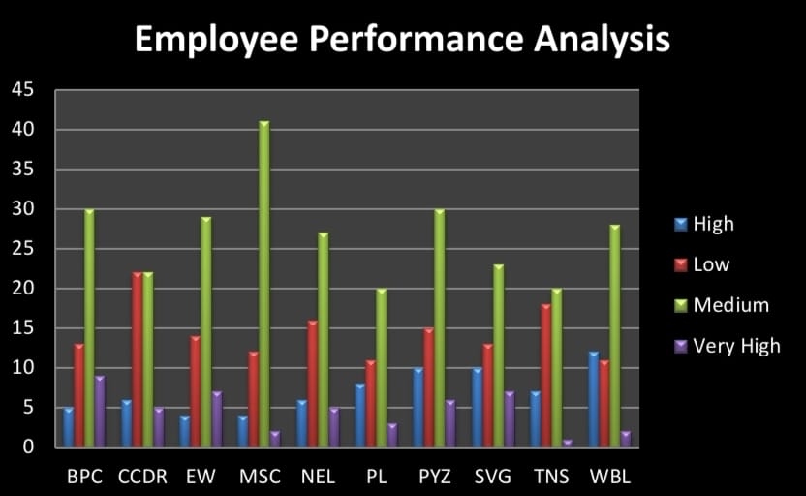
RESULTS
11

Slide 12
conclusion
effective employee performance analysis is crucial for optimizing organizational success. By leveraging integrated data, advanced modeling techniques, and objective evaluation frameworks, organizations can gain valuable insights into employee performance. This enables informed decision-making, fosters a culture of continuous improvement, and aligns employee efforts with strategic goals. Ultimately, a robust performance analysis system enhances productivity, engagement, and overall organizational effectiveness.

